Slide 1



Testing the BDT model’s ability to classify tracks across perturbed datasets
Malik Farouh – City College of CUNY
Project period: July 2025-Present
Andrew Edmonds – York College of CUNY

Slide 2
Next Steps
Model | AUC | Efficiency | Training Time | Processing New Dataset
ANN1 | 0.939 | 48.1% | 46.2s | 41s
BDT1 | 0.949 | 57.2% | 1.81s | 3.44s
Two approaches being explored:
Using XGBoost's native C++ API to load the JSON file directly
Using Sam Grant's TMVA RBDT method: exports the XGBoost model as a plain text file, which the Mu2e Offline framework can load directly at runtime
Next step: Implement one of these approaches to complete a fully sustainable retraining workflow

Slide 3
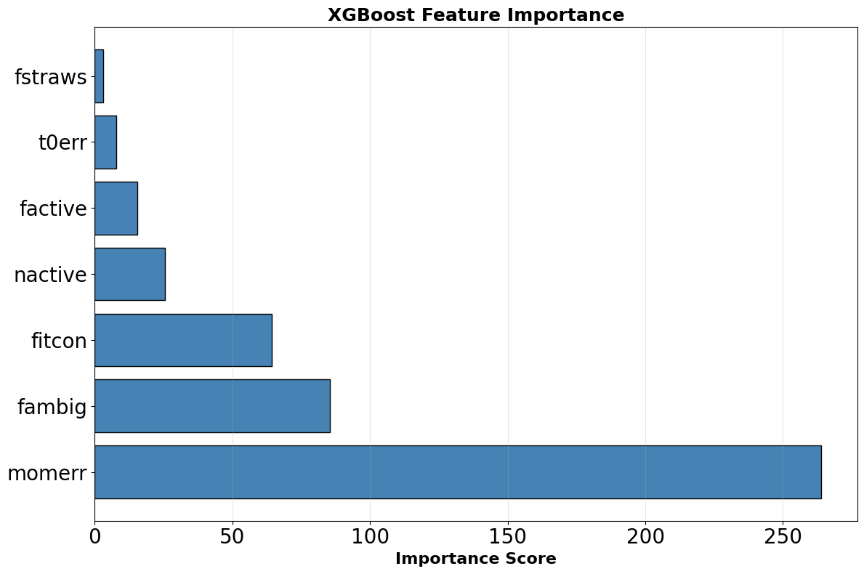
Feature Importance
It measures how heavily the XGBoost model relies on each feature to separate clean signal tracks from background.
Momerr (momentum error) heavily dominates the BDT classifier decisions, scoring over three times higher than any other feature..
High reliance on momerr means even minor calibration drifts significantly impact track discrimination
This study focuses on momerr to test the BDT's limits and ensure performance remains stable across different datasets.
One Caveat: We are changing just one feature here and that in reality we might have more features that look different.

Slide 4
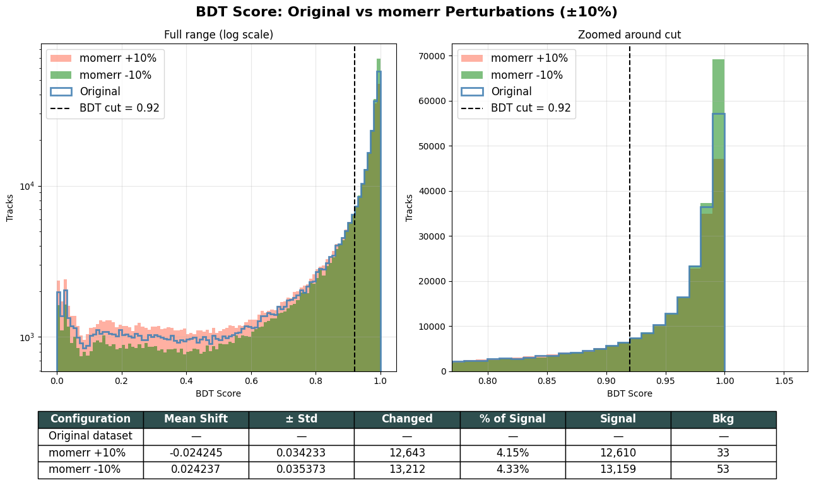
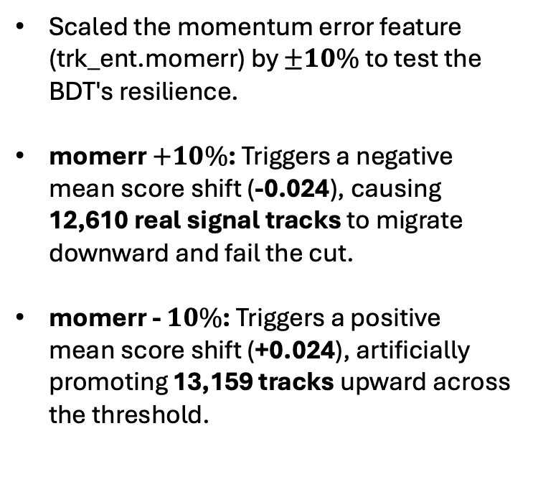
Increasing & Decreasing Momerr Column By 10%
Scaled the momentum error feature (trk_ent.momerr) by $±10\%$ to test the BDT's resilience.
momerr $+10\%$: Triggers a negative mean score shift (-0.024), causing 12,610 real signal tracks to migrate downward and fail the cut.
momerr - $10\%$: Triggers a positive mean score shift (+0.024), artificially promoting 13,159 tracks upward across the threshold.
These minor shifts force ~13,000 signal tracks to flip status, causing a 4.2% fluctuation in overall signal acceptance.
Despite the signal fluctuation, background contamination remains successfully suppressed at ≤ 53 tracks.

Slide 5
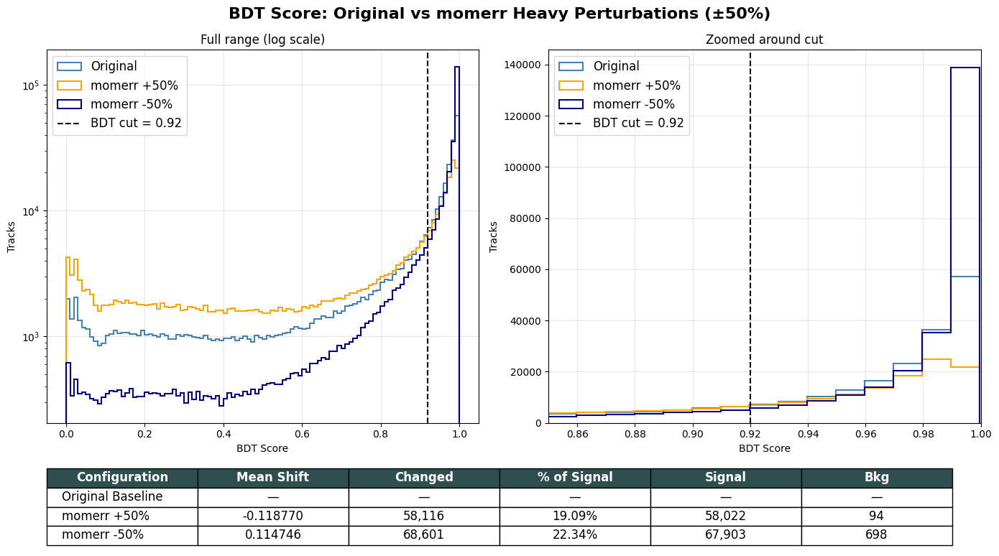
Increasing & Decreasing Momerr Column By 50%
Evaluated BDT stability under severe ±50% momerr perturbations to identify the model's operational limits
Under the original cut (0.92), an extreme shift forces about 20% of the entire signal sample to flip its pass/fail status across the fixed threshold (58,022 tracks for +50% and 67,903 tracks for -50%).
While background leakage remained negligible at lower variations, the momerr -50% case leaks 698 fake tracks into the signal region. This reveals that the background rejection boundary begins to soften under extreme optimistic scale factors.

Slide 6
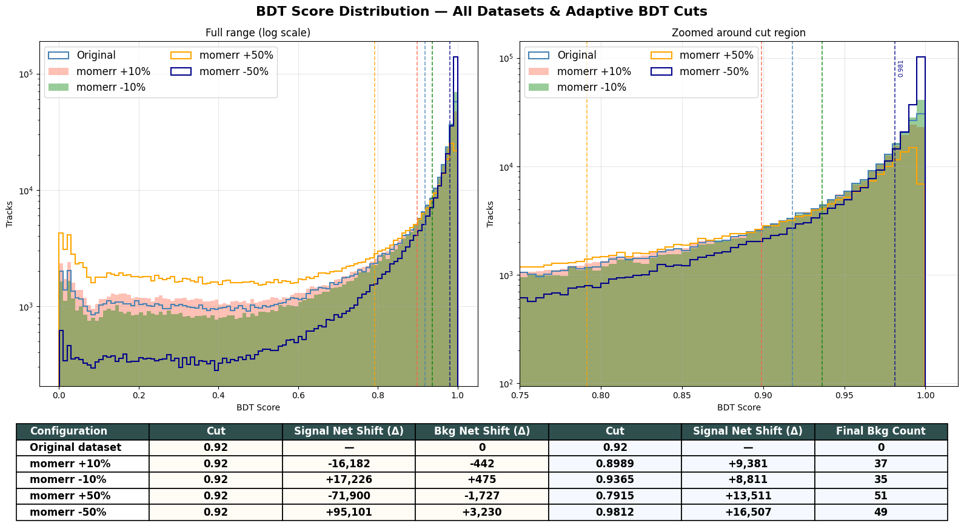
Is BDT score at 0.92 the right choice?
Static 0.92 cuts cause signal to fluctuate and background to leak.
Transitioning to adaptive cuts successfully stabilizes the physics. The threshold dynamically scales to keep the ultimate background contamination completely locked to a negligible number (≤ 51 tracks).

Slide 7
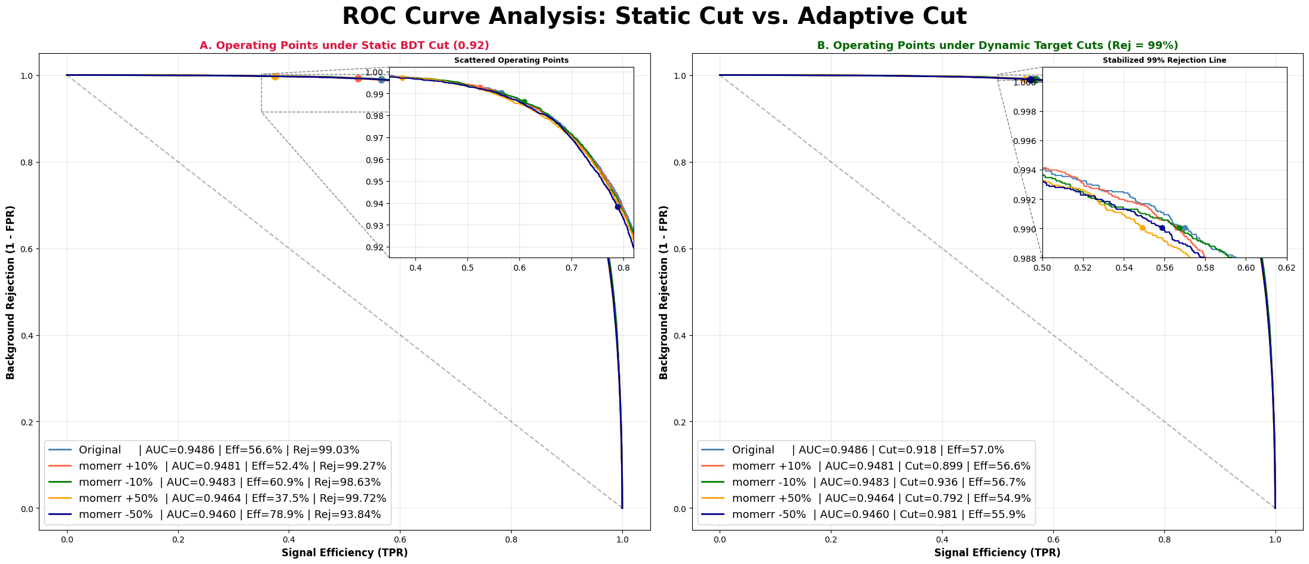
Left Panel (Static Cut): Keeping a fixed BDT cut at 0.92 across all datasets causes our performance to scatter all over the place. A pessimistic error drops our signal efficiency down to 37.9%, while an optimistic shift destroys our background rejection, letting in too many background tracks (only 93.67% background rejection).
Right Panel (Dynamic Cut): By adjusting the BDT cut dynamically for each perturbation, we completely stabilize the model. This successfully retain our background rejection to a perfectly flat, safe line at exactly 99.0%, regardless of the severity of the momerr shift.

Slide 8
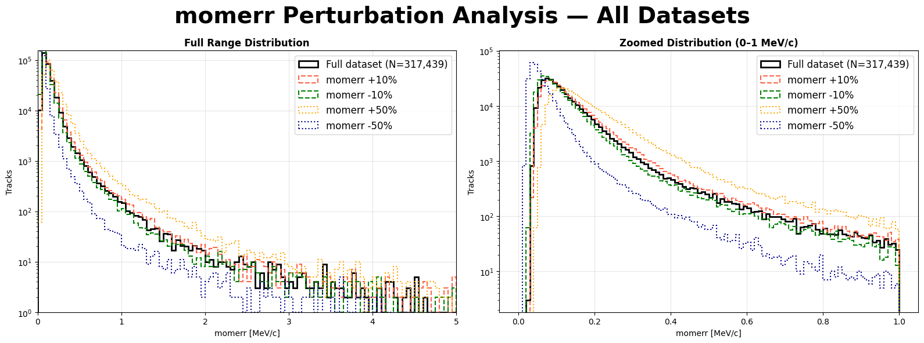
Features Plotted: Shows the raw distribution of our most dominant BDT feature, momerr (momentum error), across the full dataset (N = 317,439).
Modifying the scale factor dynamically alters the feature shape, smoothly shifting the entire tracking population along the x-axis.
A +50% shift (orange) severely broadens the long background tail, while a -50% shift (dark blue) compresses everything tightly toward zero.

Slide 9
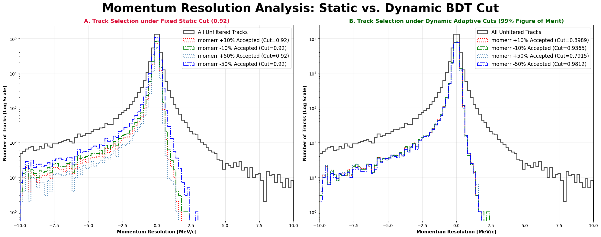
Panel A: Keeping a rigid BDT cut at 0.92 forces our physics sample to fluctuate wildly, throwing away thousands of good signal tracks or leaking massive background into the resolution tails.
Panel B: Adjusting the BDT threshold dynamically for each dataset completely fixes the spread, onto a single stable shape.
This side-by-side comparison visually proves that an adaptive BDT cut successfully insulates our data sample’s purity and stability from any background leakage.

Slide 10
Summary
Evaluated BDT resilience against significant momerr perturbations to ensure stable track classification across unseen dataset.
Fixed thresholds (0.92) are unsustainable under feature drift, resulting in either massive signal loss or severe background contamination.
Implementing dynamic thresholds successfully restores model stability, locking performance metrics to the original baseline regardless of the perturbation.
This suggests that, for future datasets, identifying the optimal adaptive BDT cut is the essential step to maintaining data purity and operational reliability.
Questions!

